Slide 1



UNIT 1
Look back 1
Part 4

Slide 2
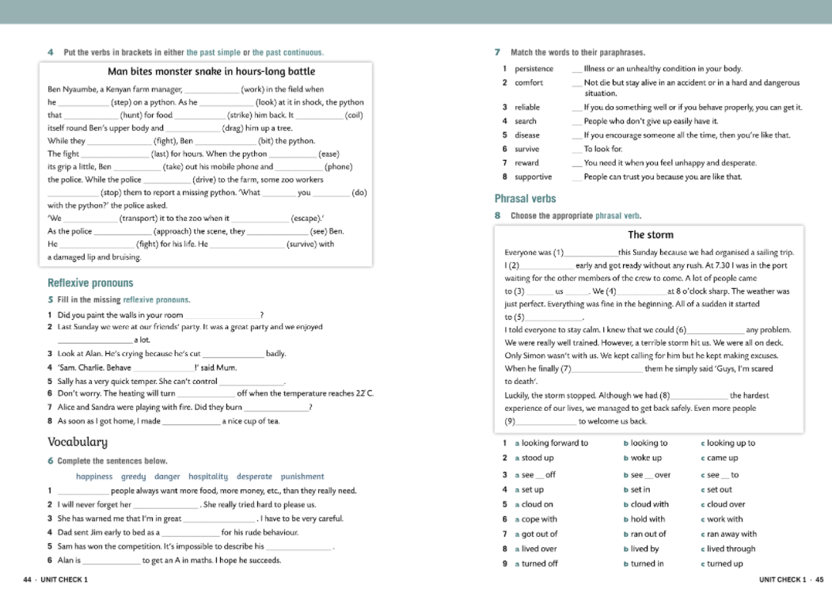
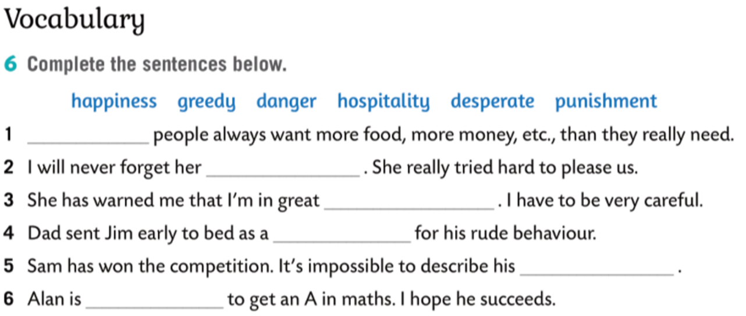
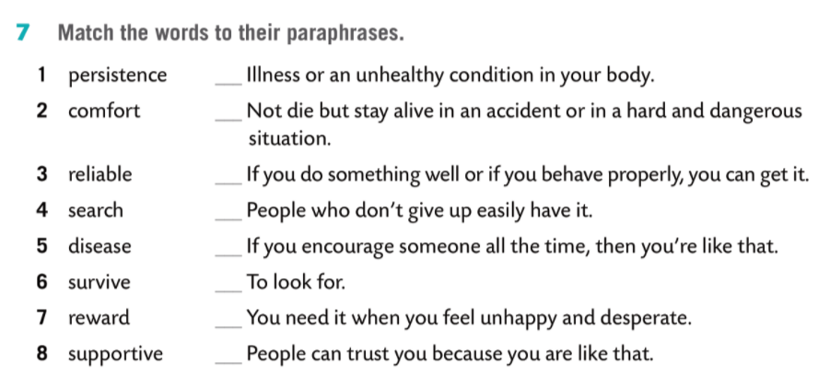
Greedy
hospitality
danger
punishment
happiness
desperate
5
6
7
1
8
4
2
3

Slide 3
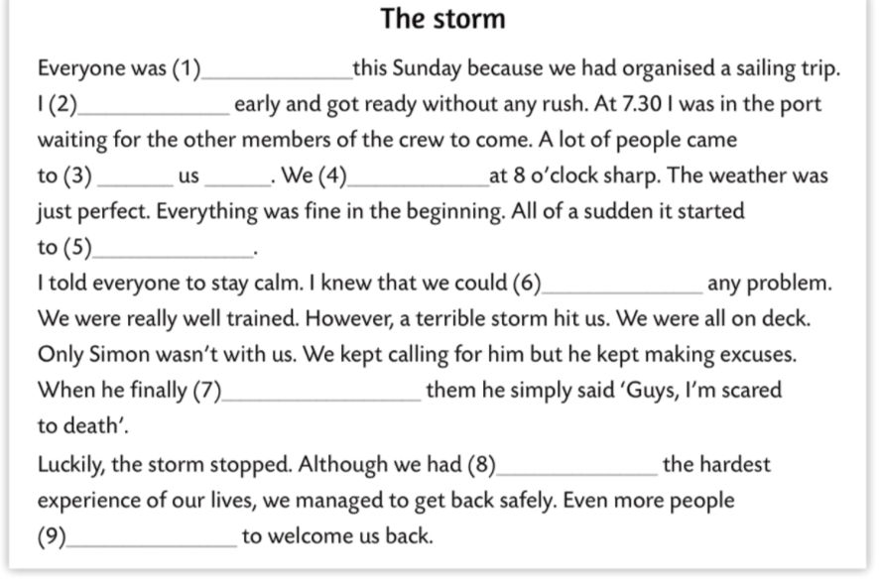

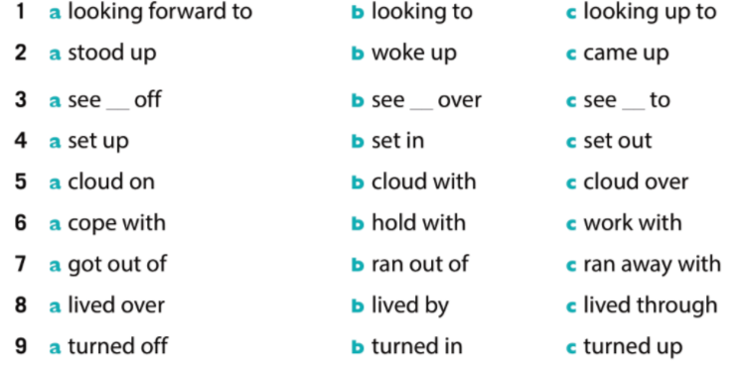

Slide 4
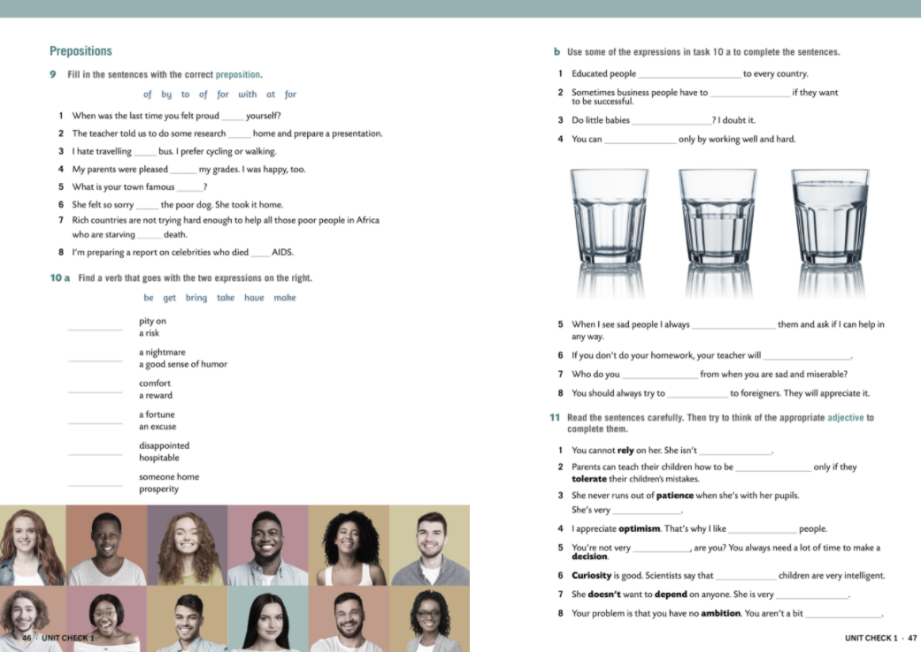
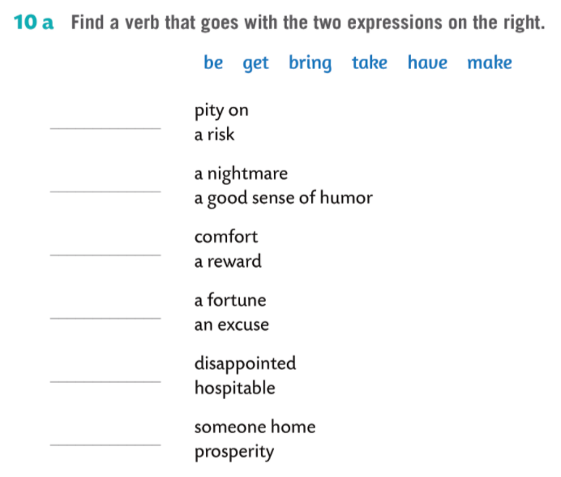
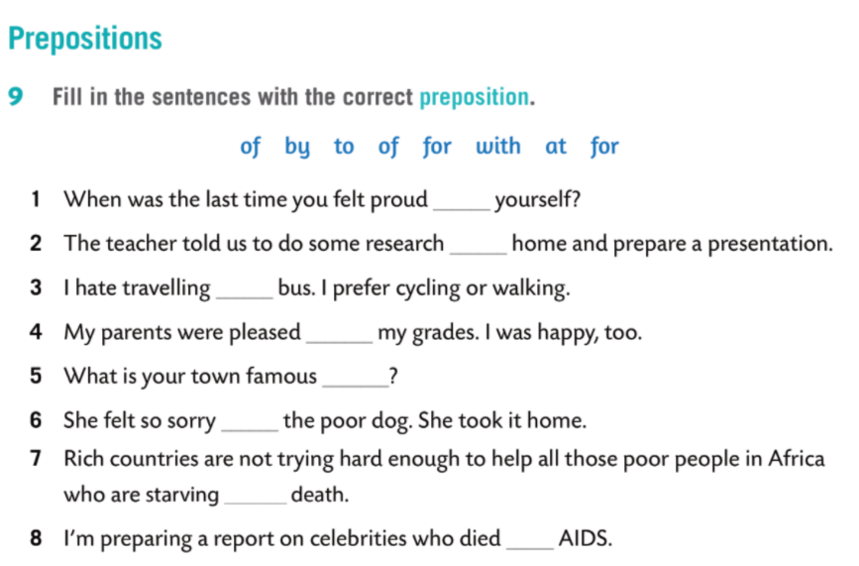
take
have
get
make
of
at
be
by
bring
with
for
for
to
of

Slide 5
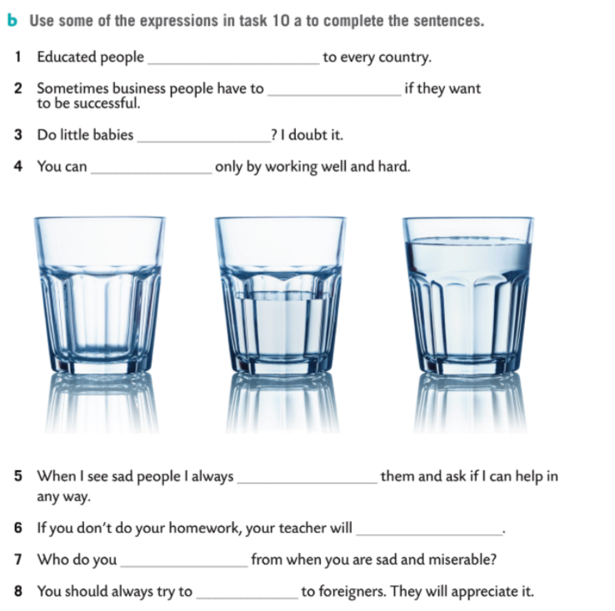
bring prosperity
take a risk
have nightmares
make a fortune
take pity on
be disappointed
get comfort
be hospitable

Slide 6
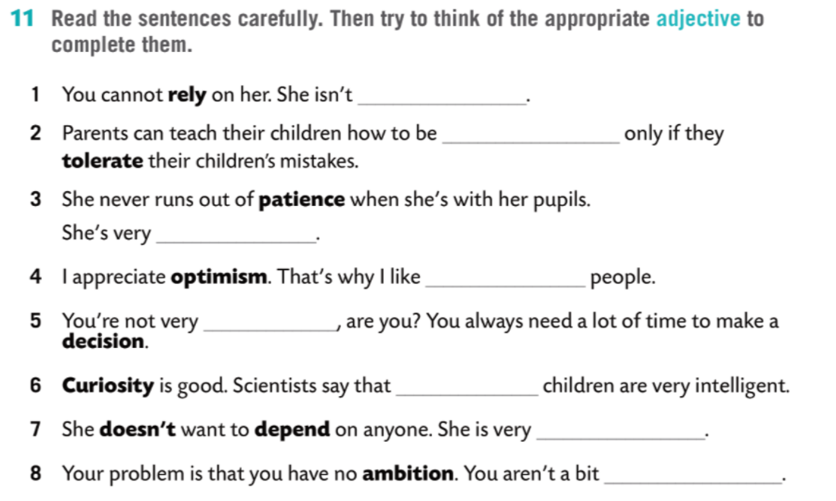
reliable
tolerant
patient
optimistic
decisive
curious
independent
ambitious

Slide 7
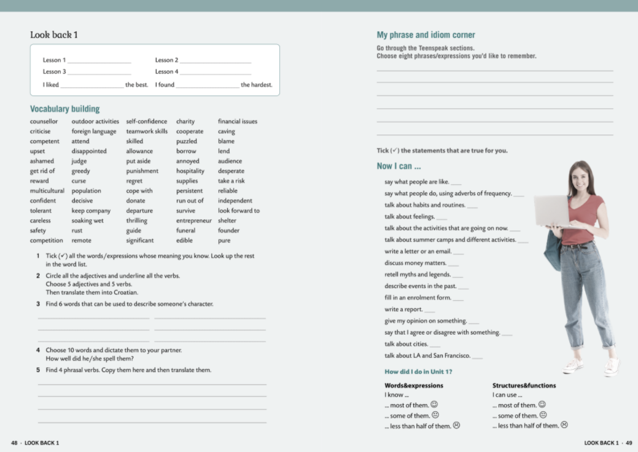

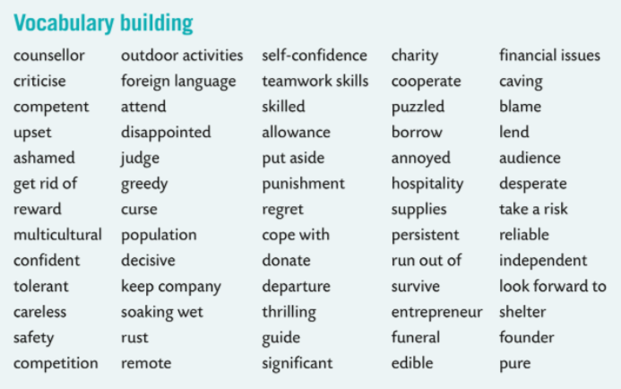

6

Slide 8
